Slide 1
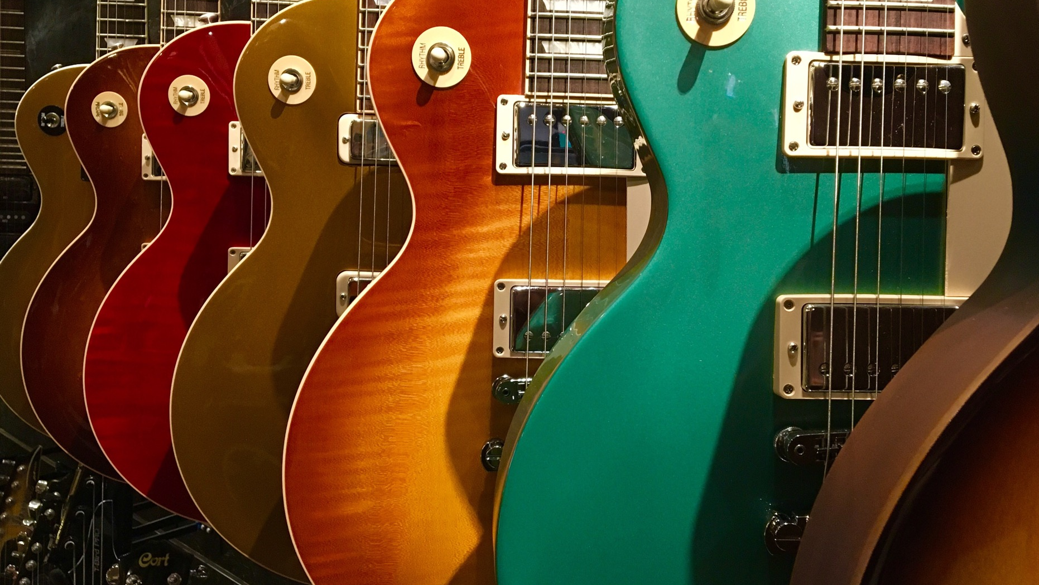
In Search of The Forth Chord
Software Architecture for the Rest of Us
Notes:
These are notes

Slide 2
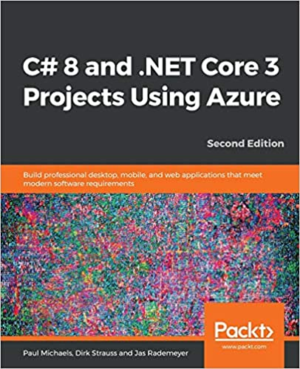
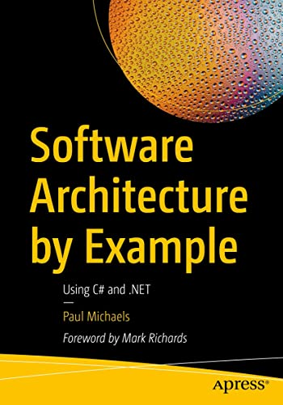
About Me: Paul Michaels
@paul_michaels
Microsoft MVP
https://www.linkedin.com/in/pcmichaels/
https://www.meetup.com/mini-hack/

Slide 3
Introduction
Software architecture is a complex topic
There are some repeatable patterns
Every system does not need to be (and should not be) a unicorn that only you understand

Slide 4
What is Software Architecture?
Non-functional requirements
Functional requirements
Documentation
Politics
Project management
Notes:
Non-functional requirements – Software speed, reliability, scale, speed to market (ilities) – reliability, scaleability, testability, sillyility, etc..
Functional requirements – what the software does
Documentation – ADRs, where are the docs, what is documented and how? Who is responsible
Politics – Can’t just ask which NFRs you want, what happens when you ask the business whether they want it testable or they want it now
Project management – if the person that designed the system doesn’t track it, the person who does track it will be less concerned about the design

Slide 5
Who is a software architect?
In the absence of an explicit software architect, one of the following may assume that role:
The loudest person in the room
Project / product manager
The person testing the software
The person writing the code
Notes:
Ultimately, unless they specifically avoid it, it’s the person that writes the code

Slide 6
Functional vs Non-Functional Requirements
Functional
Non-Functional
What is the Minimum Viable Product?
What should the software look like?
Backlog of feature requests
The software works as expected
Jira
Scaleable
Responsive
Speed
Testable
Adaptable
Readable code
Time to market
Notes:
No-one will ever ask for the column on the right, except Time to Market

Slide 7
Gathering Functional Requirements
Establish a manual process
What do you do?
How do you do it?
When do you do it?
Why do you do it?
Sketch out a flow diagram
Map each node to a ticket number

Slide 8
Minimum Viable Product
Once an MVP is established – stick to it – it’s viable!
If the MVP changes, establish a new MVP and document it.

Slide 9
Gathering Non-Functional Requirements
Never ask which NFRs a client wants
Ask about usages and limits
Ask about budget
Ask about good days and bad days

Slide 10
What problems are we trying to solve
Software Speed
Responsive / latency
Throughput
Capacity
Scale
Concurrency
State
Reliable
Usable
Availability
Secure
Speed to Market
Maintainable
Portable
Flexible
Extensible
Supportable
Deployable
Testable

Slide 11
What problems are we trying to solve?
Software Speed – you want you program to run quickly
How quick? What does quick mean?
Scale – you want your software to accommodate many users
How many?
Reliability – you want your software to be reliable
What’s an acceptable downtime? Cost of unavailability
Speed to Market
Timeframe
Notes:
Speed – or responsive
99.9% uptime = 44 minutes downtime per month
99.99% uptime = 4.38 minutes downtime per month

Slide 12
Speed
Benchmark – how fast do you need and why
What needs to be fast – does the system really need to be fast, or just responsive?
Efficient
Responsive
Usable
Operable

Slide 13
Scale
Define scale
Is the scale in peaks and troughs
Available
Notes:
Define scale – what’s the numbers behind the system
Can the scale you want be solved with a CF waiting room?

Slide 14
Reliable
What do we mean by reliable?
Is available and usable
Has no faults
Secure
Supportable and supported
Tested (all software is tested)
Integrity
Accuracy
Fault tolerant
Recoverable
Stable
Usable
Testable
Observable
Supportable

Slide 15
Time to Market
Deployable
Software must be easily deployed
Flexible
Must be easy to make changes
Repeatable
How long would it take you to rebuild your infrastructure?
Compliant
Deployable
Composable
Interoperable
Easily Testable
Notes:
All software is testable – it’s just who tests it

Slide 16
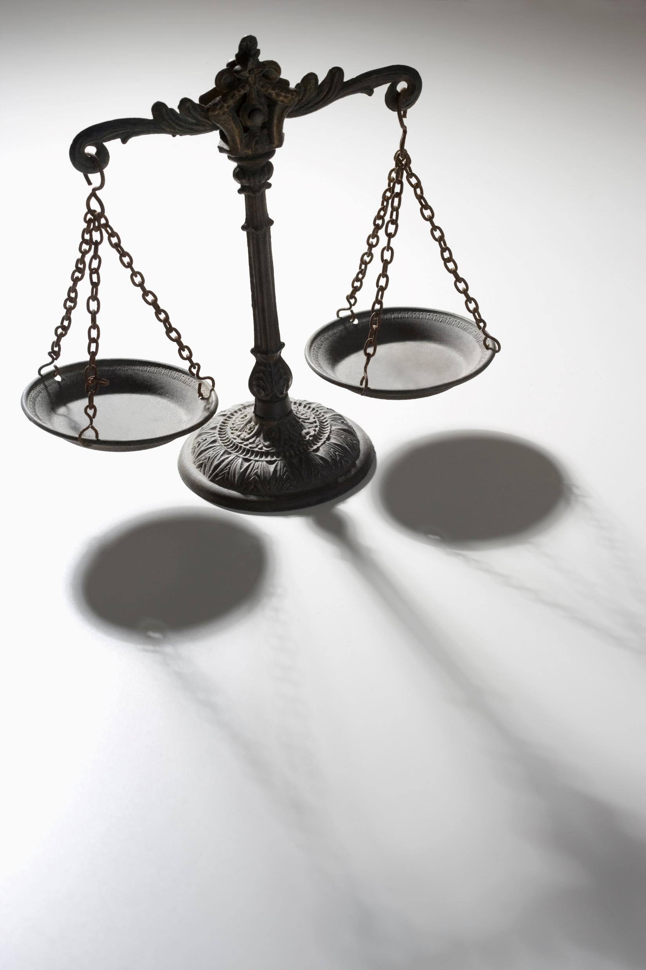
Decision Time
What characteristics are important to the successful use of the system
Who can make that decision
Once a decision has been made – it should be documented
ADR
Wiki
Discussion Boards (not Teams)

Slide 17
Caveat
Nothing is free
Can’t (and shouldn’t) be applied to everything
Some of these patterns require significant investment and a change in approach

Slide 18

Three Chords

Slide 19
Using an Event Broker
Event Driven Systems
Microservices
Queues
Pub / Sub
Notes:
We’ll talk more about pub/sub here

Slide 20
Pub Sub
Flexible
Testable
Extensible
Concurrent
Resilient
Responsive

Slide 21
The Problems
Coupling
High Load
Slow User Experience

Slide 22
Logical Coupling
Service 1
Service 2
Must know what the service is (REST / SOAP)
Must know where the service is (https://www.myapi.com/blah)
Must know what the service does (Accepts customer details and returns acknowledgement that the customer is created)
Notes:
Default communication method is something like an API call
Service 1 calls Service 2 directly, that means…

Slide 23
Logical Coupling - Example
CRM Back End
Customer Service
{
“CustomerName”: “Smiths”,
“CreatedBy”: “Someone”,
“OpeningBalance”: “10.00”,
“CustomerAddress”: “12 Palace Road, …”
}
CreateCustomer
{
“Successful”: “True”,
“RecordId”: “1234”
}
Notes:
Service 1 calls Service 2 directly, that means…

Slide 24
Logical Coupling - Example
CRM Back End
Customer Service
{
“CustomerName”: “Smiths”,
“CreatedBy”: “Someone”,
“OpeningBalance”: “10.00”,
“CustomerAddress”: “12 Palace Road, …”
}
CreateCustomer
{
“Successful”: “True”,
“RecordId”: “1234”
}
Notes:
Service 1 calls Service 2 directly, that means…
When Service 1 – or the CRM back end, called Service 2, or the Customer Service, it created a dependency – if service 2 changes, service 1 breaks

Slide 25
Temporal Coupling
Service 1
Service 2
Method1
Method2
Where a consumer must know the sequence in which the service requires methods to be called
Notes:
Method2 depends on Method1 being executed first

Slide 26
Temporal Coupling - Example
CRM Back End
Customer Service
CreateCustAddress
CreateCustomer
Where a consumer must know the sequence in which the service requires methods to be called
CreateCustomer requires an address record to be created

Slide 27
System Load
Service 1
Service 2
Service 1 calls Service 2 too frequently
Whilst Service 2 may be able to cope with the load, it may slow down
Service 1 may time out waiting for a reply

Slide 28

User Experience
User Interface
Service 1
Service 2
User places an order
Service 1 calls service 2 and waits for a response (maybe a stock check?)
Service 2 takes a while, by the time it responds the user may have lost patience, or even had the client time-out
Notes:
Talk about unstable internet connection (BB)

Slide 29
How Services Communicate
Service 1
Service 2
In a similar fashion to IoC, you do create a dependency on the broker itself
However, you can abstract this away to an extent
Notes:
At a really basic level

Slide 30
Logical Coupling
Services no longer need to know the location of other services.
Services will not directly break because data has been changed upstream.
Services are no longer dependant on the health of upstream services.
Services no longer care what up and downstream services do.

Slide 31
However
Services are now dependent on a message broker.
Although services will not directly break because upstream services have changed, if they are expecting data that has changed in format, they can still break.
Although a service may not care what up and downstream services do, those things still need doing.

Slide 32
Temporal Coupling
Still have a dependency on a sequence of events
Separating tasks into logical blocks linked by a message broker tends away from Temporal Coupling
Whilst each event may need to occur in a sequence, that sequence is not known to any single other process

Slide 33
System Load
Each service collects tasks as it is ready
The message broker acts as a shock absorber
Multiple services can deal with the same queue or topic
Load can be distributed across processes and therefore machines

Slide 34
User Experience
Fire and forget can lead to a worse (at least different) user experience
Response times are much faster, as you no longer actually wait for the response
But what if you need a response?

Slide 35
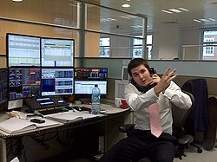
Demo – Message Broker
This Photo by Unknown Author is licensed under CC BY-SA
Notes:
Terminal:
docker run --rm -it --hostname my-rabbit -p 15672:15672 -p 5672:5672 rabbitmq:3-management
Debug -> Start
SoftwareArchitectureTalk/MessageBroker.Receive
Run SoftwareArchitectureTalk/MessageBroker.Send
Pub/sub in Rabbit is fanout or topic (topic allows specific routing)
Show code

Slide 36
Store the Event History of the System
Event Sourcing
Store and process server-side events
Audit
Notes:
Event sourcing – the common term for this practice
Store and process server side events – typically don’t store client events
Audit – draw a distinction between this and auditing

Slide 37
Event Sourcing
Reliable
Testable
Maintainable
Supportable
Resilient

Slide 38
The Problems
Historical Context
Data Loss
Realistic Test Data

Slide 39
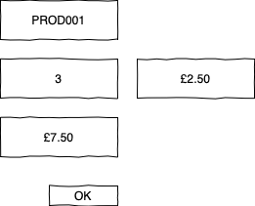
Event Sourcing Sales Order
Cancel Sales Order 12
New Sales Order 32
New Sales Order 31
Despatch Order 23

Slide 40
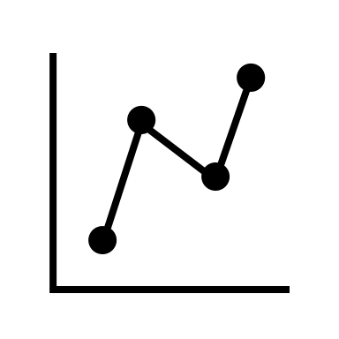


Event Sourcing
Auditing for free
Accurate log of everything that has happened to the system
Testing
Data Consistency
Startup Time
Complexity

Slide 41

Demo – Store Event History of the System
Notes:
Run EventSourcing.Write
Run EventSourcing.Read

Slide 42
Separate Writes and Reads
CQRS
Scaling
High Throughput

Slide 43
CQRS
Speed
Resilient
Concurrent
Flexibility

Slide 44
The Problems
Event Sourcing
Data Access Speed
Locking
Notes:
Umbraco cache

Slide 45
Separate Reads and Writes (CQRS)
Write
Read
Notes:
Separating the two makes reads and writes very fast, as all DBs have a tradeoff in some way between the two activities
Somehow, you have to join the databases

Slide 46
Summary
Software Architecture is complex
There are repeatable, tried and tested, patterns
Every solution has a cost

Slide 47
Resources
https://github.com/pcmichaels/SoftwareArchitectureTalk (Git repo for this talk)
https://www.pmichaels.net/ (My Site)
https://www.developertoarchitect.com/ (Mark Richard’s site)

Slide 48

Questions

